Slide 1
EIB’s Activity in the Water Sector in the Danube Region
Marco Beroš,
Lead Engineer, Water Management Division
Projects Directorate
EUROPEAN INVESTMENT BANK

Slide 2
Contents: - EIB Activity in the Water Sector - EIB Water Projects in the Danube Region - Case Studies: Moldova

Slide 3
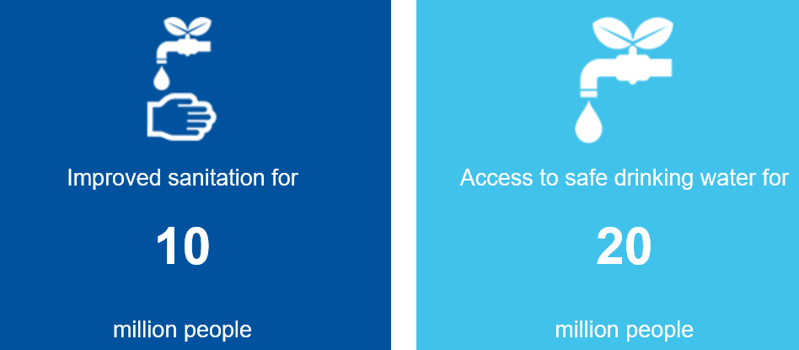
EIB Activity in the Water Sector
1. General
Largest international lender to the water sector worldwide,
Total loan amount of EUR 36bn over the past 10 years, 90% of which for projects inside EU,
Over the past 10 years, 300 major projects have been financed, 75% of which located within the EU.
Expected Outcome of the projects financed in 2018

Slide 4
EIB Activity in the Water Sector
1. General (cont.)
EIB lending covers the whole water cycle (water resources, water supply, sanitation, flood protection).
EIB lends to public or private utility companies, national or local authorities or directly for project finance deals.
EIB can mobilise technical assistance, for both project preparation and implementation;
EIB can finance large individual operations under investment loans or small operations under framework or global loans;
EIB cannot finance more than 50% of the project investment cost (on average, EIB lending represents 30% of the project investment cost);
For more data and media material click here:
http://www.eib.org/en/projects/sectors/water-and-waste-water-management/index.htm?f=search&media=search

Slide 5
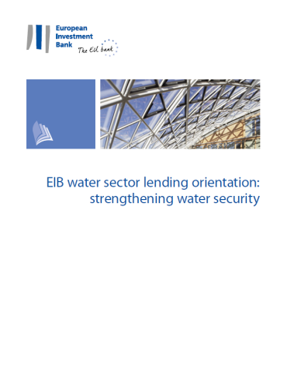
EIB Activity in the Water Sector
2. EIB’s Water Sector Lending Orientation⁽¹⁾
River basin approach (IWRM)
Sector development
Adaptation to climate change
Water efficiency
Development of new water supply
Wastewater and sanitation services
Research and Innovation
Maximise Added Value
(1) Published in December 2017. Available here:
http://www.eib.org/attachments/strategies/eib_water_sector_lending_orientation_en.pdf

Slide 6
EIB Activity in the Water Sector
3. Implementing the Orientation: Key Actions (1/2)
IWRM (Integrated Water Resources Management):
Promote IWRM + water services provision in a project
Support transboundary cooperation
Consolidation of institutional framework:
Support appropriate level of integration of utilities to improve efficiency and enhance borrowing capacity
Enhance financial sustainability (sustainable cost recovery)
Adaptation to climate change:
Adaptation is part of EIB’s Climate Action Commitment
Promoters should consider adaptation in project design
EIB supports technical assistance (TA) with grants
Preparation, implementation of flood risk management projects

Slide 7
EIB Activity in the Water Sector
3. Implementing the Orientation: Key Actions (2/2)
Water efficiency:
Support efficiency in: (i) use by consumers; (ii) allocation of resources; (iii) systems (losses); (iv) management of utilities
Promote principle of cost recovery in line with WFD⁽¹⁾
Support industries aiming at improving “water footprint”
Development of new water supply:
Demand side management and efficiency as 1st priority
Finance: (i) desalination with pre-requisites; (ii) dams, basin transfers and fossil water under strict conditions
Wastewater and sanitation services:
Always consider them when undertaking water supply projects
Sustainable cost recovery (incl. subsidies)
Sustainable financing (blend loans, grants)
(1) EU Water Framework Directive (2000/60/EC)

Slide 8
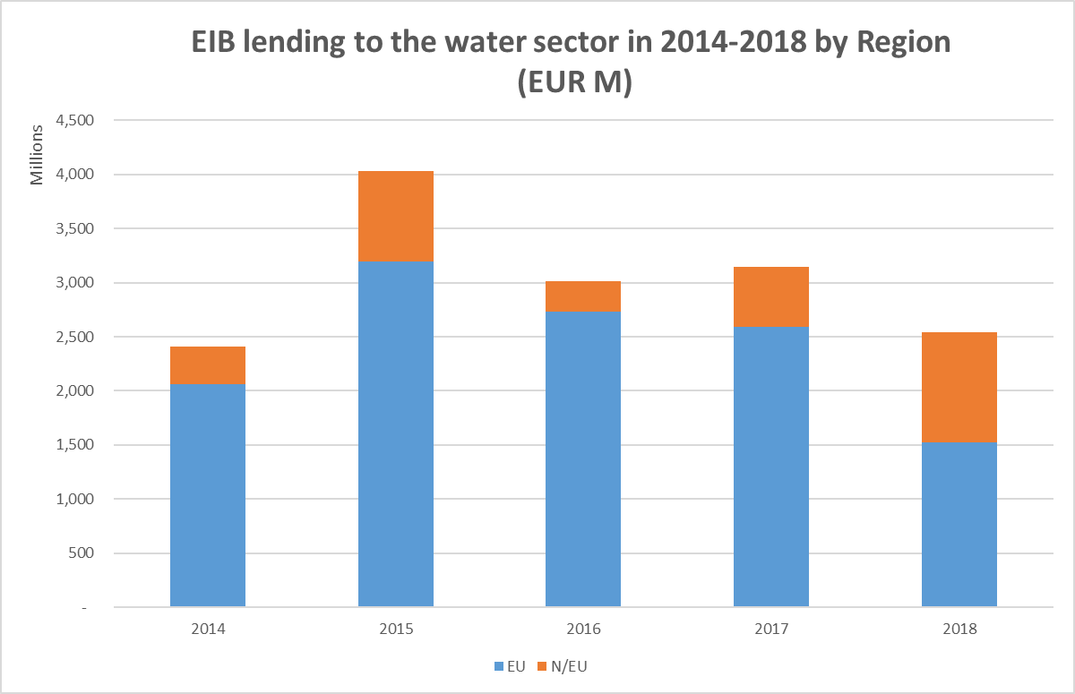
EIB Activity in the Water Sector
4. Key Figures 2014-2018: EUR 14.2 bn signed
Over the past 5 years: average of EUR 2.8 billion p.a.

Slide 9
EIB Activity in the Water Sector
4.1 Key Figures 2014-2018 by Region: European Union

Slide 10
EIB Activity in the Water Sector
4.2 Key Figures 2014-2018 by Loan Type
Unit | Invest-ment Loans (IL) | Frame-work Loans* (FL) | Multi-sector Global Loans** | Pro-gramme Loans*** | Equity/Quasi-equity | Total
EUR bn | 11.57 | 1.17 | 1.02 | 0.37 | 0.03 | 14.16
Share | 81.7% | 8.3% | 7.2% | 2.6% | 0.2% | 100%
Number | 124 | 51 | N.A.**** | 17 | 9 | 201
Share | 62% | 25% | N.A | 8% | 5% | 100%
* Water sector FL and water sector allocations of multi-sector FL
** Water sector allocations of multi-sector Global Loans (a GL is a multi- beneficiary loan intermediated by a bank)
*** Small and similar IL under global Board approval (so far only used in Italy)
**** Water sector allocations under Multisector GL between 2014 and 2018 concern a total of over 200 operations signed between 2007 and 2018

Slide 11
EIB Activity in the Water Sector
4.3 Key Figures 2014-2018 by Ownership Type:
Unit | Private Sector | Public Sector* | Total excluding Global Loans**
EUR bn | 3.98 | 9.16 | 13.14
Share | 30% | 70% | 100%
Number | 34 | 167 | 201
Share | 17% | 83% | 100%
* Definition of public sector borrower: Public Sector Ownership above 50%
** Information on ownership type is not available for allocations under multi-sector Global Loans

Slide 12
EIB Activity in the Water Sector
4.4 Key Figures 2014-2018 by Sub-Sectors:
Unit | Water supply* | Waste-water | Storm water | Coastal protection | Flow control, dykes | Total
EUR bn | 6.83 | 5.45 | 0.21 | 0.41 | 1.26 | 14.16
Share | 48% | 39% | 1% | 3% | 9% | 100%
*Includes EUR 30m for desalination projects

Slide 13
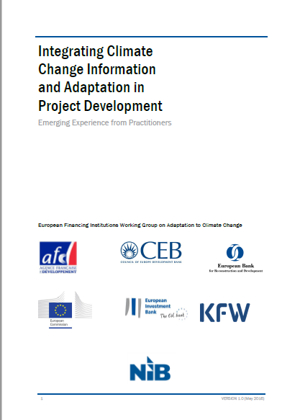
EIB Activity in the Water Sector
5. EIB’s Climate Action Commitment
“We are supporting the transition to a low-carbon, environmental friendly and climate-resilient economy. As the largest multilateral provider of climate finance worldwide, we commit at least 25% of our lending portfolio to low-carbon and climate-resilient growth.”
In 2018 EIB’s climate financing totalled EUR 16 billion (29%)
EIB is member of the European Financing Institutions Working Group on Adaptation to Climate Change (EUFIWACC) which issued a Guidance Note in 2016.⁽¹⁾
We want to demonstrate the climate impact (adaptation and/or mitigation) of all our water and waste water projects!
https://www.eib.org/en/projects/priorities/climate-and-environment/climate-action/index.htm?f=search&media=search

Slide 14
EIB Water Projects in the Danube Region

Slide 15
EIB Water Projects in the Danube Region
1. Signed Water Sector Loans Inside the European Union (8 countries) 2014 - 2018
Country (start of EIB activity) | Loan Amount (EURm) | JASPERS TA⁽¹⁾
Austria (1973) | 166.73
Bulgaria (1992) | 0.02 | X
Croatia (1977) | 1.38 | X
Czech Republic (1992) | 3.93 | X
Hungary (1990) | 0.19 | X
Romania (1991) | 364.67 | X
Slovakia (1992) | 1.75 | X
Slovenia (1977) | 9.33 | X
TOTAL | 548.00
Typical co-financing partners:
EU Structural Funds, national/local sources
(1) Joint Assistance to Support Projects in European Regions. For more info:
https://jaspers.eib.org/

Slide 16
EIB Water Projects in the Danube Region
2. Signed Water Sector Loans Outside the European Union (8 countries) 2014 - 2018
Country (start of EIB activity) | Loan Amount (EURm) | JASPERS TA | EPTATF TA⁽¹⁾
Albania (1995) | 0.00
Bosnia & Hercegov.(1977) | 7.11
Kosovo (1977) | 0.00 | X
Moldova (2007) | 10.00 |  | X
Montenegro (1977) | 36.40 | X
North Macedonia (1977) | 0.00 | X
Serbia (1977) | 0.09 | X
Ukraine (2007) | 190.00 |  | X
TOTAL | 243.60
Typical co-financing partners: EU Grants, national and/or local sources, EBRD
(1) Eastern Partnership Technical Assistance Trust Fund. For more info:
https://www.eib.org/en/products/blending/donor-partnerships/trust-funds/eastern-partnership-technical-assistance-trust-fund

Slide 17
EIB Water Projects in the Danube Region
3. Some Issues more or less typical for the Danube Region
Project preparation (with/without TA?)
Financial viability of the projects (tariff levels, affordability)
Project implementation TA (capacity building vs. capacity substitution)
Capacity and funding for operation phase (tariff levels, regulators)

Slide 18
Case Studies: Moldova EIB’s four Operations in the Water Sector: 1. Moldova Urban Development Programme 2. Chisinau Water 3. North Moldova Water 4. Flood Management TA and project

Slide 19
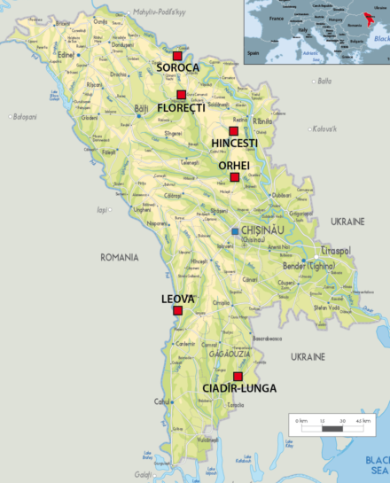
1. Moldova Urban Development Programme (1/4)
Overview
Purpose: create regional operating companies (ROC) in small towns & villages to create and/or rehabilitate basic water and sanitation infrastructure
Project cost: EUR 30 million
Financing: loans (EBRD 10m, EIB 10m) and 10m EU grant
Borrower: Republic of Moldova
Promoter: Ministry of Environment
Beneficiaries: 200,000 inhabitants in agglomerations of Soroca, Floresti, Hincesti, Orhei, Leova, Ciadir-Lunga

Slide 20
1. Moldova Urban Development Programme (2/4)
Timeline
2007: feasibility study and identification of suitable towns
2008: first selection of towns
2009: appraisal of the project, final selection of towns, tender for due diligence study,
2010: due diligence study, signature of the loans, tender for PIU consultant,
2011: signature of EU-EIB-EBRD implementation agreement, start of implementation,
2015: end of implementation
Before the project

Slide 21
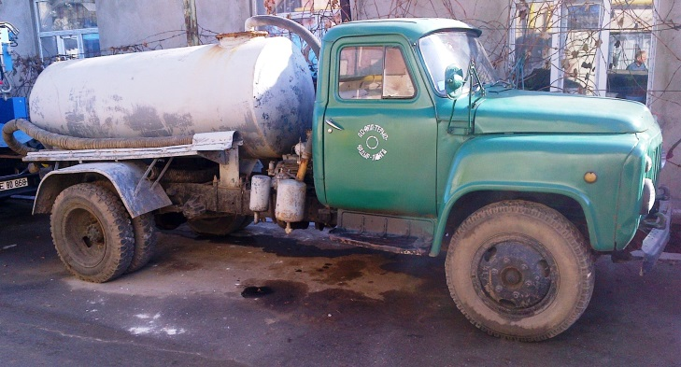
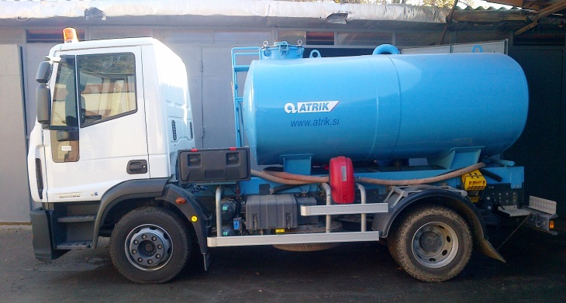
1. Moldova Urban Development Programme (3/4)
Challenges/Lessons learned
Regionalisation: willingness of towns to create regional operators varies,
Implementation: selection of PIU consultant is critical,
Tariff conditions: tariff increases politically difficult
Overall investment capacity: limited despite large grant component
Operation: sustainability only through continued assistance,
Before the project
Before
After

Slide 22
1. Moldova Urban Development Programme (4/4)
Results
Indicator | Unit | Project
Water Supply |  | Feasibility Study | Achieved | Difference
Capacity of water treatment plant constructed or rehabilitated | m³/day | 1440 | 2496 | +62%
Length of water mains or distribution pipes built or upgraded | Km | 278.78 | 538.7 | +93%
Connections created or rehabilitated | Nr | 17,894 | 18,649 | +4%
Population benefiting from safe drinking water (Note 1) | Househ. | 64,008 | 63,898 | ~0%
Energy consumption water supply | kWh/m³ | 1.43 | 1.41 | -1%
Non revenue water | % | 35% | 29% | - 6 points
Service level | % | 100% | 98% | -2%
Indicator | Unit | Project
Wastewater |  | Feasibility Study | Achieved | Difference
Capacity of sewage treatment plant constructed or rehabilitated | p.e. | - | - | -
Length of sewers and/or stormwater pipes built or upgraded | Km | 33.59 | 104.33 | +211%
Connections to sanitation services created or rehabilitated | Nr | 3,320 | 5,091 | +53%
Population benefiting from sanitation services | Househ. | 10,567 | 13,438 | +27%
Energy consumption sewerage | kWh/m³ | 0.84 | 0.71 | -15%

Slide 23
2. Chisinau Water (1/3)
Overview
Purpose: rehabilitate the capital’s water and sanitation infrastructure
Project cost: EUR 61.8 million
Financing: loans (EBRD 24m, EIB 24m) and 13.4m EU grant
Borrower: Apa-Canal Chisinau
Promoter: Apa-Canal Chisinau
Guarantor: Municipality of Chisinau
Beneficiaries: 800,000 inhabitants of Chisinau agglomeration
Notes:
By clicking on both links are available to the respective sites of the Bank and Fund

Slide 24
2. Chisinau Water (2/3)
Timeline
1997: first EBRD loan to Apa-Canal Chisinau for emergency measures
2004: completion of this project
2010: tender for Chisinau water and sanitation master plan,
2012: conclusion of the master plan,
2013: appraisal of the project and signature of the finance contracts with EBRD and EIB
2014: start of implementation
2017: First disbursements
2018: Start of works on the Wastewater Treatment plant
Notes:
By clicking on both links are available to the respective sites of the Bank and Fund

Slide 25
2. Chisinau Water (3/3)
Challenges/Lessons learned so far
Institutional situation: public service agreement, new regulator, etc.
Implementation: unable to build upon PIU structure of previous project (“brain drain”),
Tariff conditions: tariff increases politically difficult
Notes:
By clicking on both links are available to the respective sites of the Bank and Fund

Slide 26
3. North Moldova Water (1/2)
Overview
Purpose: rehabilitate and expand water infrastructure, create regional operating company
Project cost: EUR 30 million
Financing: loans (EBRD 10m, EIB 10m) and 10m EU grant
Borrower: Republic Moldova
Promoter: Ministry of Environment
Beneficiaries: 230,000 inhabitants in the districts of Soroca, Floresti, Drochia, Riscani, Singerei, Telenesti and in Balti municipality
Notes:
By clicking on both links are available to the respective sites of the Bank and Fund

Slide 27
3. North Moldova Water (2/2)
Timeline
2009: first study to rehabilitate the Soroca-Balti-pipeline,
2012: tender for feasibility and PPP study,
2013: conclusion of the feasibility study and appraisal of the project,
2014: signature of the finance contracts with EIB and EBRD,
2017: Promoter fails to:
Meet tariff conditions
Settle historical debt
Create Regional operator
2018: EBRD and EIB cancel their loans
Notes:
By clicking on both links are available to the respective sites of the Bank and Fund

Slide 28
4. Moldova Flood TA and Project
Context and overall objectives
Request for support from Ministry of Environment further to the 2010 floods
Objectives:
Develop a countrywide Flood Management Master Plan and investment programme
Enhance Ministry of Environment’s capacity
Set up institutional conditions in line with EU Floods and Water Framework Directives
Take into account past and ongoing initiatives from other lenders and donors (EU, World Bank, UNDP/UNEP, Czech Cooperation, OECD, etc.)
Funding from EPTATF (Eastern Partnership Technical Assistance Trust Fund): EUR 2m approved in Nov. 2011
Start of consultant’s assignment: October 2013

Slide 29
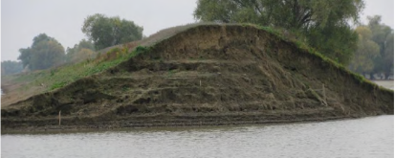
4. Moldova Flood TA and Project
Tasks of the TA assignment
Preliminary Flood Risk Assessment
Hydraulic Modelling and preparation of Flood Hazard Maps
Flood Risk Assessment (FRA)
Define Objectives and Strategies
Identification of measures for flood risk management
Development of Phased Investment Program
Development of a Short Term Investment Plan (STIP)
Implementation of a GIS based River Management and Monitoring System
Capacity Building

Slide 30
4. Moldova Flood TA and Project
Main Results
Assessment of existing infrastructure (3,000km of flood defenses, 5,000 dams and reservoirs, LIDAR and on-site surveys, etc.);
High level hydraulic modelling of 12,000km of rivers, of which 3,400 km modelled in detail with review of historic flood events;
Preparation of flood hazard maps in line with EU Floods Directive;
Estimate of hydropower potential (1200 kW, 7,300 MWh/year);
Development of strategic options for flood risk management and approval by stakeholders;
Identification of structural and non-structural / technical assistance measures;
Development of phased investment plan over next 20 years (EUR 450 million) and Short Term Investment Plan (STIP) over the next 7 years (EUR 100m); STIP ready to be appraised.
Project waiting for approval by the Government since March 2016

Slide 31
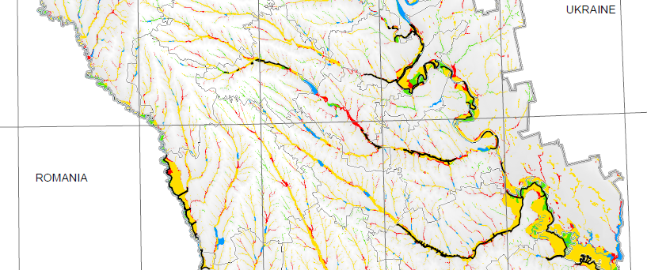
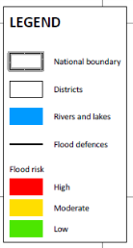
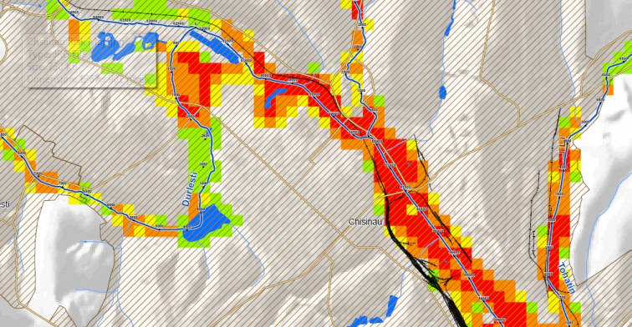
4. Moldova Flood TA and Project
Extract of country-wide flood risk map
Extract of detailed flood risk map for Chisinau

Slide 32
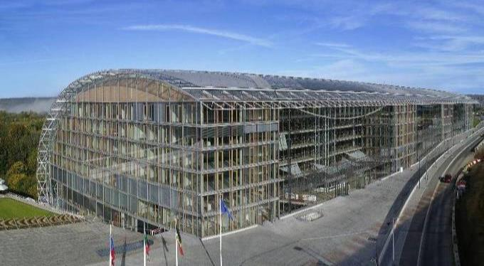
THANK YOU FOR YOUR ATTENTION!
For more information please contact :
Marco Beros (m.beros@eib.org), phone +352 43 79 827 48
EUROPEAN INVESTMENT BANK
http://www.eib.org/

